Slide 1
Intrinsic Evaluation of Text Based Document Representation Models
Better Together

Slide 2

Better Together

Slide 3
SciBERT
BERT-style model trained on full text from Semantic Scholar (Beltagy et al., 2019)
1.14M papers
“18% papers from the computer science domain and 82% from the broad biomedical domain”
“Full text” → English only!

Slide 4
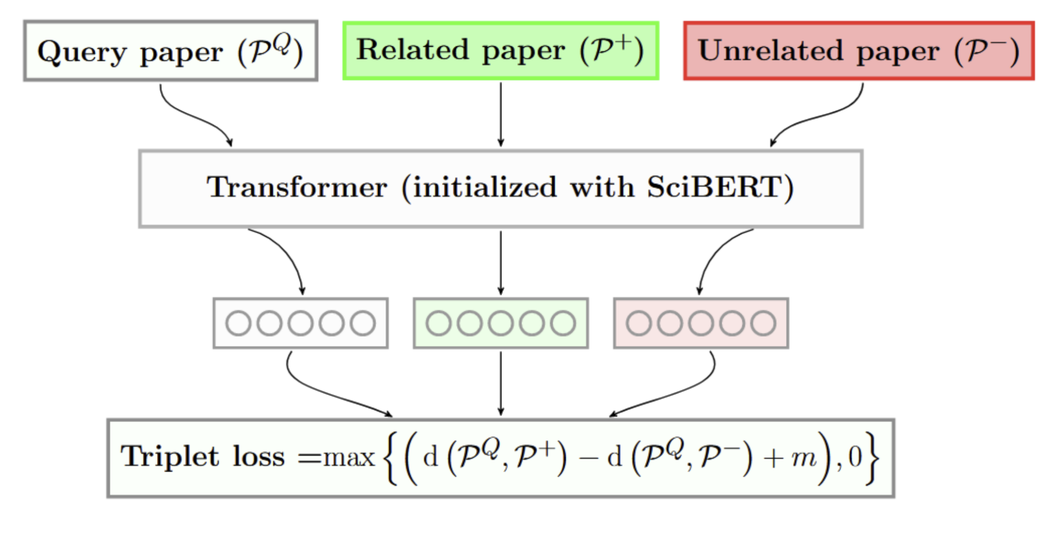
SPECTER
Document representation model based on Transformers (Cohan et al., 2020)
Post-pretraining alignment of SciBERT using citation graph

Slide 5
Goal: Intrinsic Evaluation of SPECTER
Hypothesis 1: The quality of SPECTER embeddings can only be as good as the quality of SciBERT representations
We can use perplexity to intrinsically evaluate how “expected” a piece of text is to the language model (SciBERT)
Hypothesis 2: The quality of SPECTER embeddings should be correlated to the perplexity of SciBERT

Slide 6
Perplexity as evaluation
Hypothesis: Perplexity is important. Document representation quality is related to the quality of the underlying language model
Language model perplexity is a measure of how “expected” a piece of text is to the model
So, we can use this measure as a signal of how well we would expect a model to represent a given document

Slide 7
How can we use this?
Evaluate how well the model can represent papers from different time periods and sources
Find specific areas that the model can improve on
How robust is the model to text written after its training data?
i.e. How variable is our scientific language over time?

Slide 8
Research Questions
RQ1: Is the perplexity of scientific text, with respect to a given model, consistent over time and domain?
If not, what are the potential causes for variation?
RQ2: Will language models produce high quality representations for scientific text produced after the model’s release?

Slide 9
Experimental Setup
Partitioned papers from Semantic Scholar into 100 bins of equal size
Sample 5,000 abstracts from each bin
Representative sample – do not just evaluate the model on data it’s been trained on
Calculate a perplexity per-bin for multiple models

Slide 10
Experimental Setup: Data
Some data cleaning is required:
Filter abstracts with less than 75 characters
Filter abstracts with less than 10 unique characters

Slide 11
Experimental Setup: Perplexity Calculation
BERT-style models do not have a well-defined perplexity
Instead, use model scoring (Salazar et al., 2021) to calculate a pseudo-perplexity (per-subword)

Slide 12
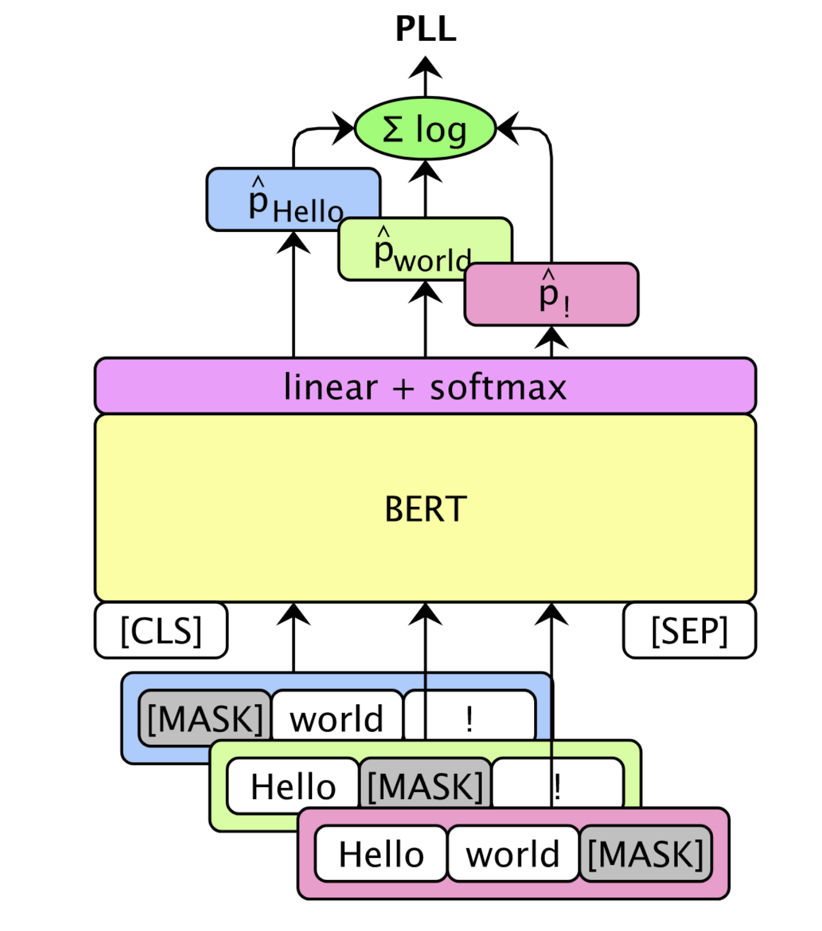
Pseudo Perplexity (PPPL)
BERT-style models do not have a well defined perplexity
Instead, use model scoring (Salazar et al., 2021)

Slide 13
Pseudo Perplexity (PPPL)
“patricks pickled peppers”
[CLS]
pat
##ricks
pick
##led
pepper
[SEP]
101
26227
23587
3368
2433
18700
102
log(p(pat))
∑ = PLL(w)
|V|
log(p(##ricks))
log(...)
log(...)
log(...)
Pseudo log-likelihood
101
[MASK]
23587
3368
2433
18700
102
101
26227
[MASK]
3368
2433
18700
102
101
26227
23587
[MASK]
2433
18700
102
101
26227
23587
3368
[MASK]
18700
102
101
26227
23587
3368
2433
[MASK]
102
Notes:
BERT-style models do not have a well defined perplexity
Instead, use model scoring (Salazar et al., 2021)

Slide 14
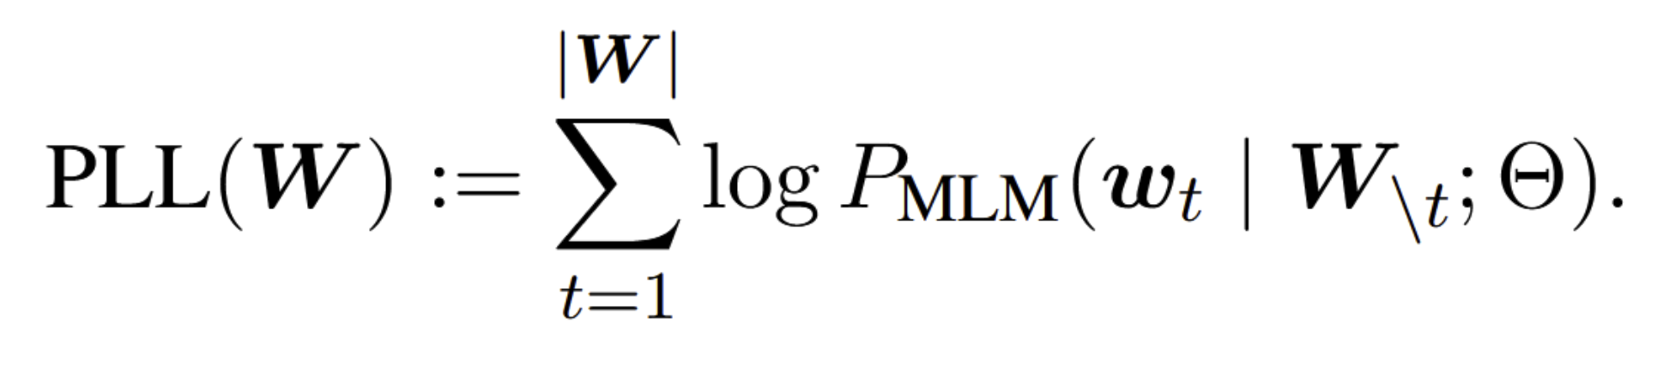
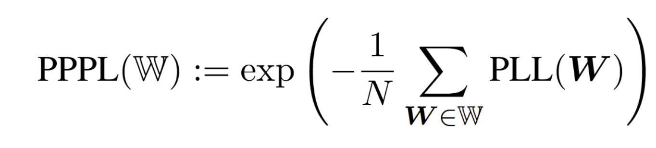
Scoring Calculation:
Abstract
# Tokens in Bin
Bin

Slide 15
Experiment Setup: Scoring
Get scores for the filtered abstracts: tokenize the abstracts, and use a maximum sequence length of 128
Further filtering:
Discard anything with more than 64 pad tokens
Discard anything with more than 10 [UNK] tokens
Results: plot pseudo-perplexity for each bin

Slide 16
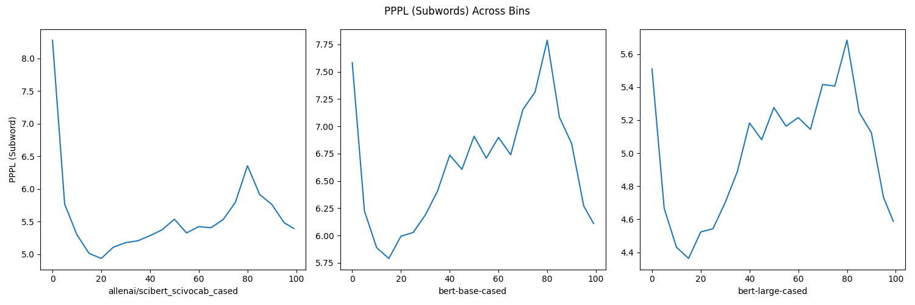
Past Analysis of BERT-like Models
Observations: see changes in perplexity across time (RQ1)
The perplexity difference from one bin to the next bin is relatively small

Slide 17
Past Analysis of BERT-like Models
Observation: pattern is the same for other BERT models

Slide 18
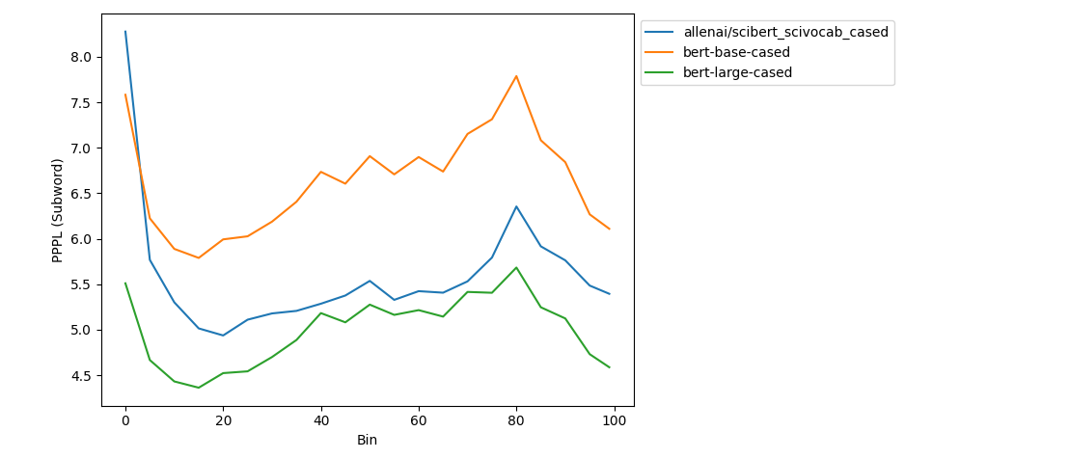
Past Analysis of BERT-like Models
Same vocabulary: directly comparable
More parameters in the model yields better perplexity

Slide 19
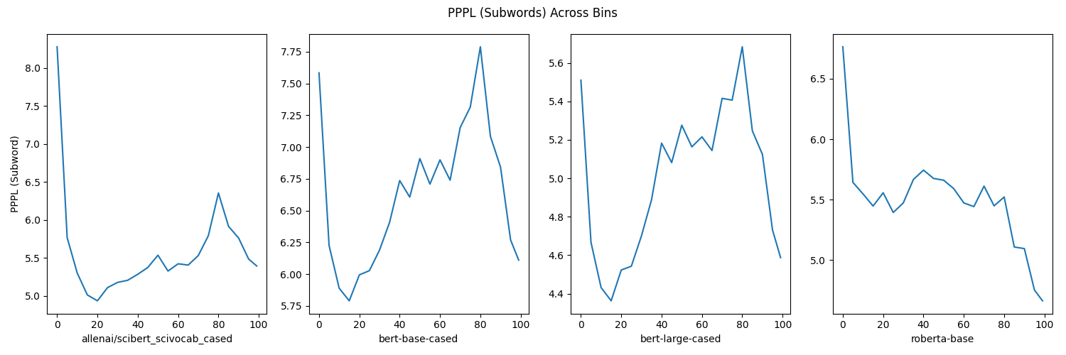
Other Architectures
Different architecture shows different trend

Slide 20
Comparison Across Vocabularies
Normalization value is the number of subwords,
which is different across tokenizers
Can use a count which is more consistent across models:
Words (Moses tokenization)
Characters
Spaces
Normalizer

Slide 21
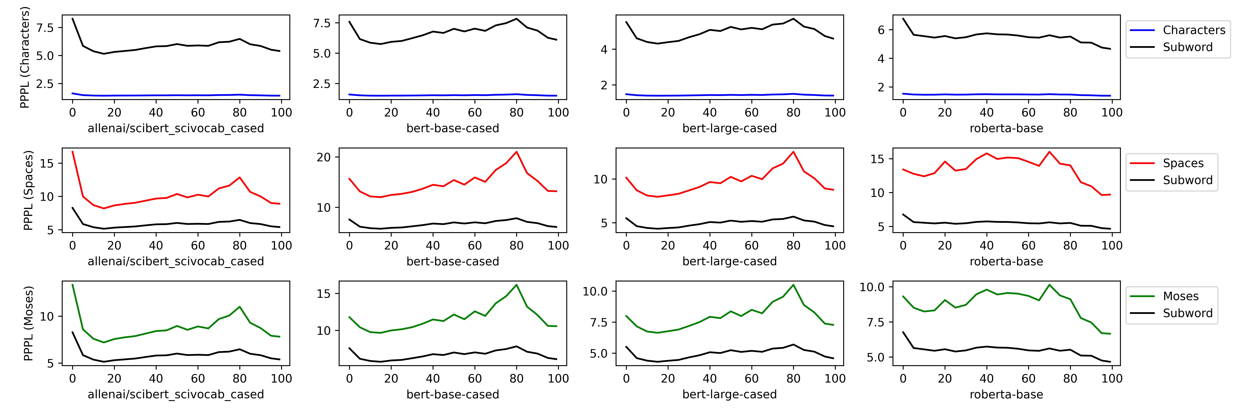
Different Normalization Methods

Slide 22
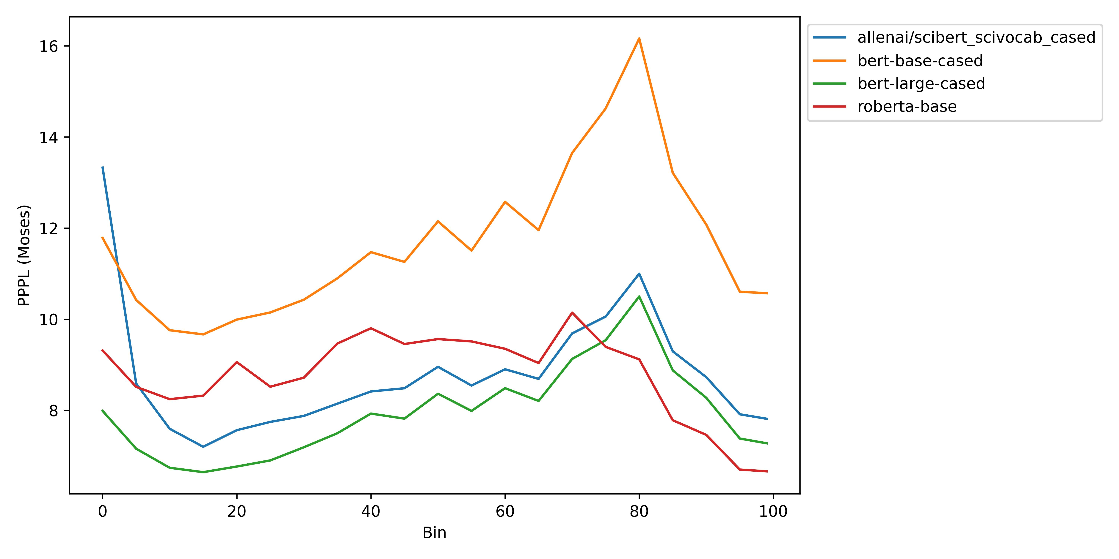
Model Comparison
Even with more consistent normalization, we still see the same ranking of models and trends over time

Slide 23
Reasons for this structure over time?
Features of language: is our writing style, vocabulary use, syntax, etc. changing over time? (Enough that it affects the model performance)
Features of the data: papers from new sources are suddenly added in one year, data from some years is noisy, etc.
Need to focus on the data before we can make claims about language

Slide 24
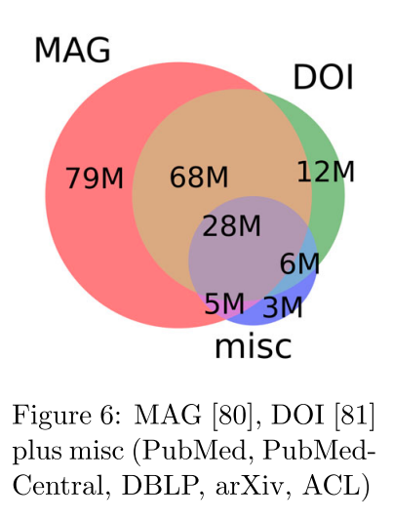
Data Features: Language and Source
Stratify the perplexity scores by filtering by source and language
Different sources may have different levels of quality control
Languages other than English will have a large effect on perplexity

Slide 25
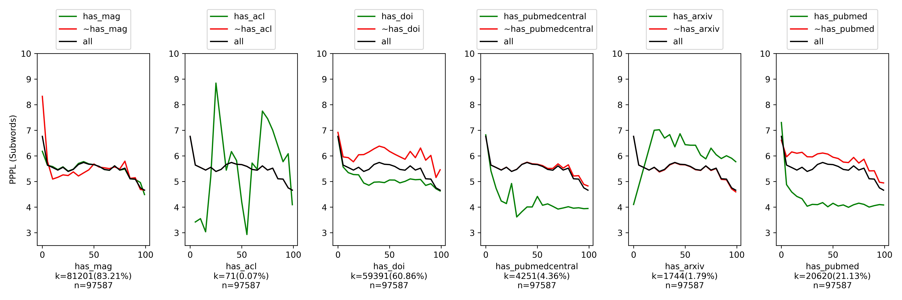
Stratifying by Source
Perplexity low and consistent for papers from PubMed, which makes up for ~20% of the sample
Papers not from PubMed are heavily influencing the shape of the perplexity curve
Similar story for DOI: papers without DOI are influential

Slide 26
Stratifying By Source Domain
MAG is less informative
ACL and ArXiv are too small in the sample to say anything

Slide 27
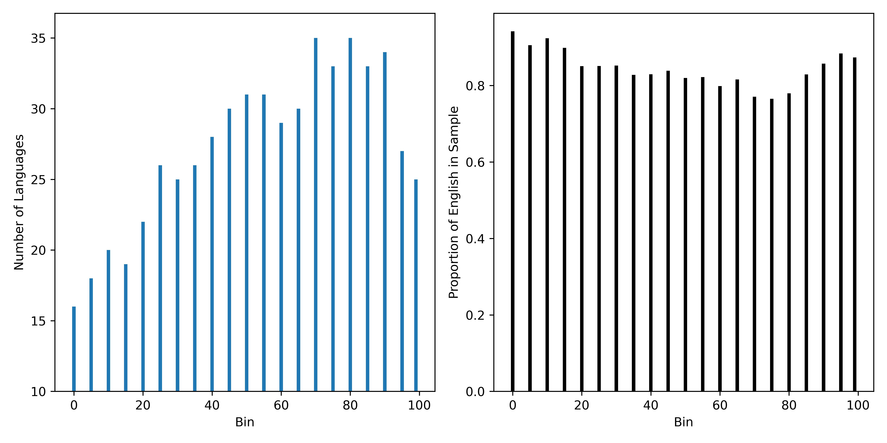
Stratifying by Language
Run language detection on the abstracts
Finding: multilinguality!

Slide 28
Stratifying by Language
English is still dominant: at least 80% of papers in all bins are English
How large is the effect?
Compare perplexities to that of a multilingual model
Stratify by abstracts which are English and non-English

Slide 29
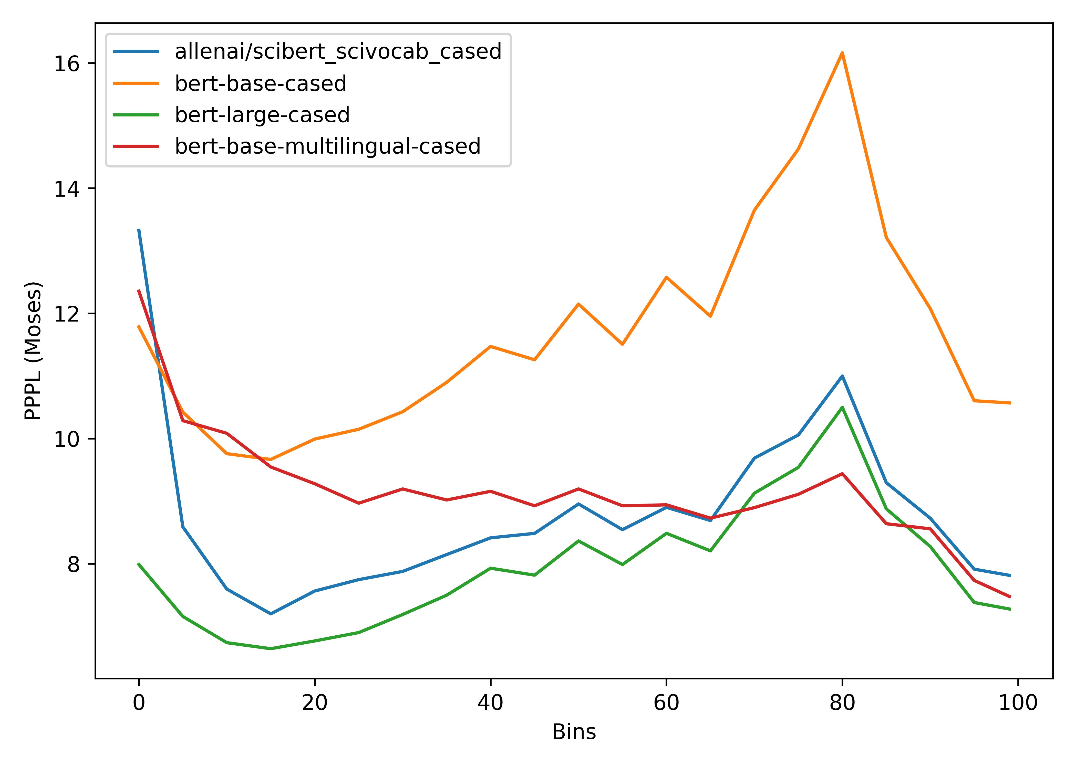
Multilingual Models
As the number of languages increases (peak at 80), perplexity of the model decreases

Slide 30
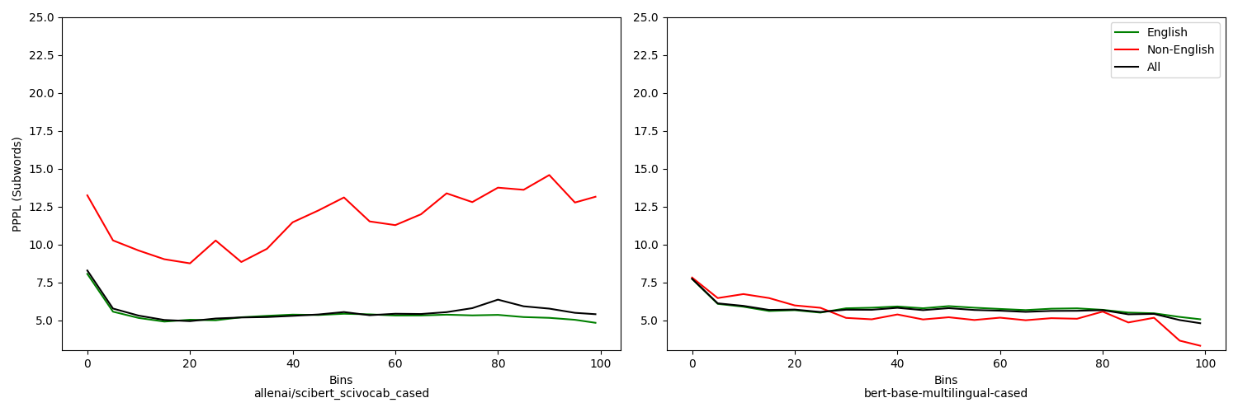
Effect of Non-English Abstracts

Slide 31
Takeaways: Multilinguality
Our scientific literature is multilingual, our models should be too
SciBERT, SPECTER, and SciRepEval all fail the Bender Test (Bender, 2011)
Not only are they trained solely on English, but they fail to mention that they are in English
If our models are trained on English and our evaluation is only in English we are ignoring a large piece of scientific literature
Better Together: A citation is a citation regardless of language.

Slide 32
So far:
Seen that the structure we noticed in our perplexities is largely due to the data:
More non-English papers affect the English-only models
Can we still analyze features of the languages?
RQ2: Will language models produce high quality representations for scientific text produced after its release?
Look at perplexities for only clean, English data

Slide 33
“Clean” Data
What do we consider to be “clean” data?
PubMed as a source is much cleaner
Perplexities on PubMed data are low and consistent

Slide 34
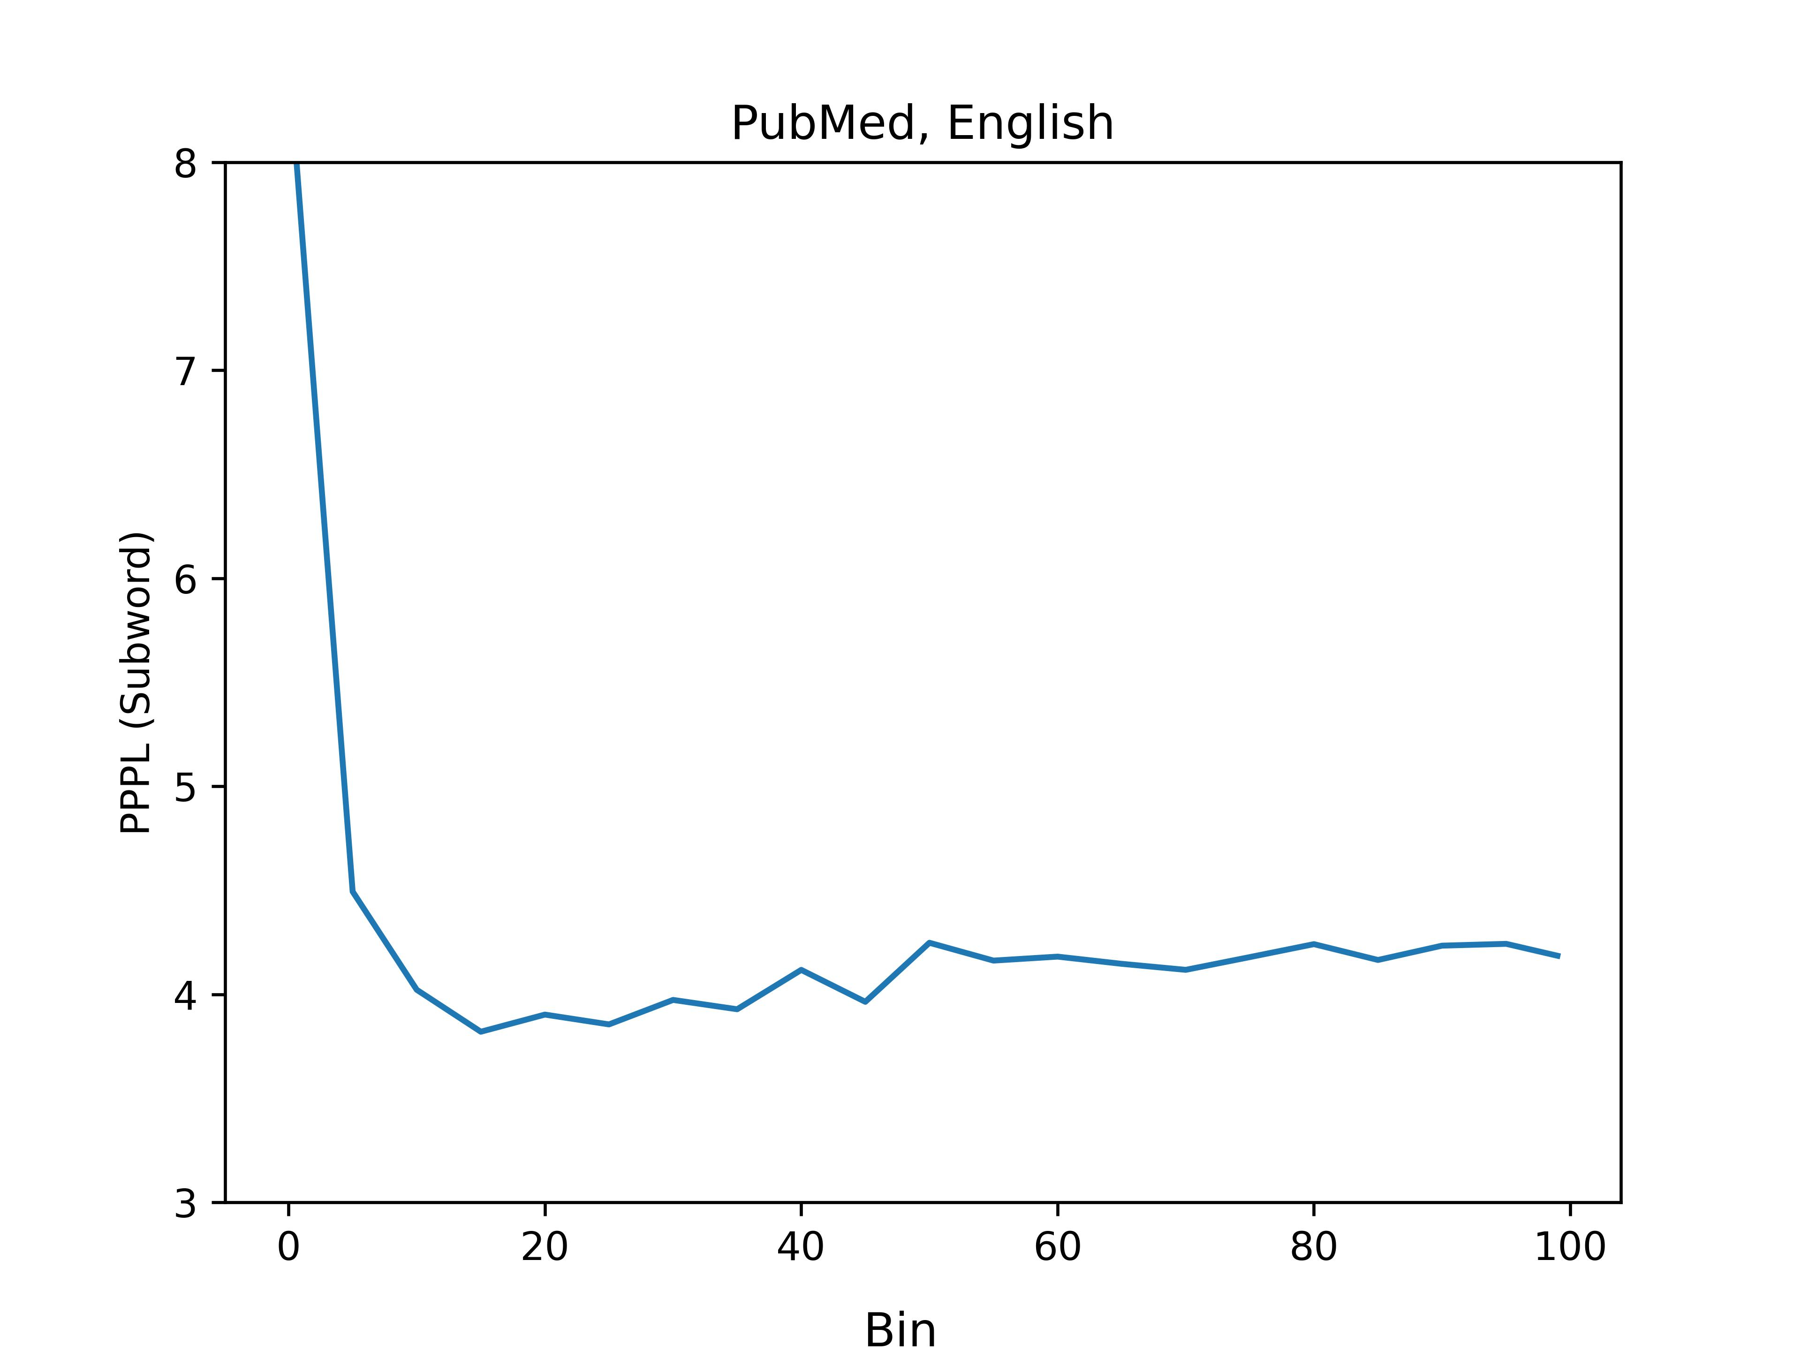
“Clean” Data
Perplexity for clean data is largely flat
Intuition: this is the training data, the model is very good at handling it
Can’t say anything about language changes over time
But, this doesn’t mean it doesn’t exist
Use other metrics on a sample of PubMed

Slide 35
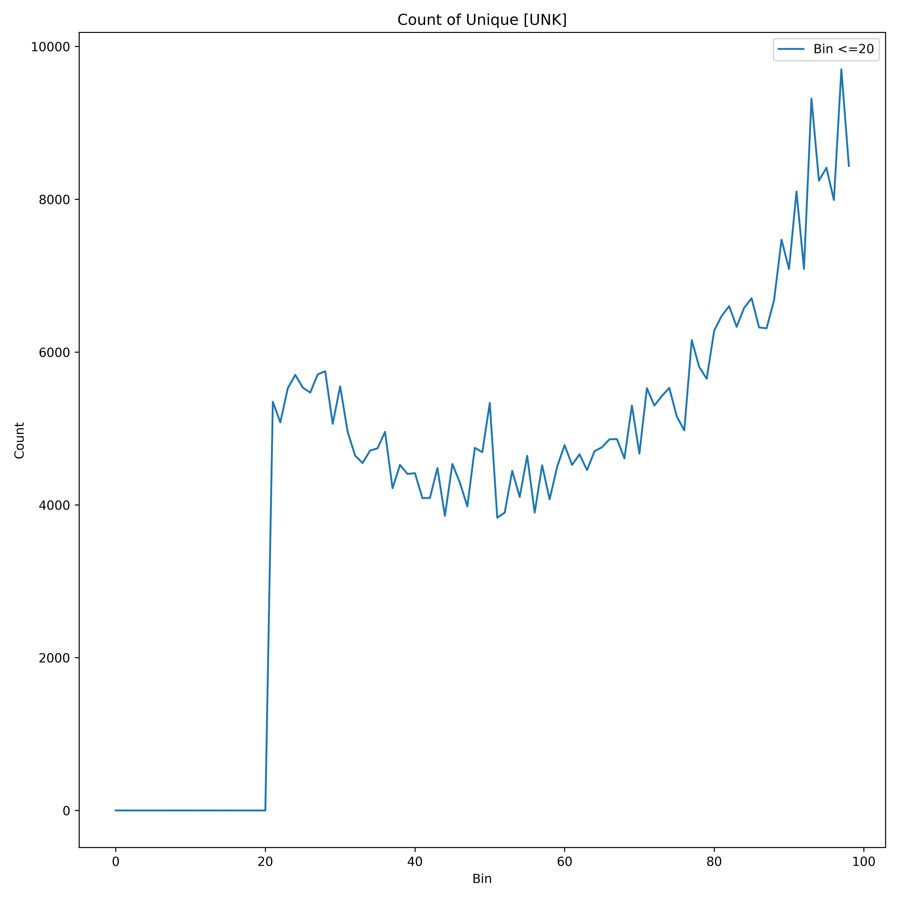
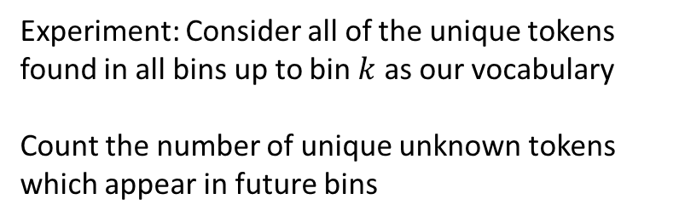
Emergence of New/UNK Tokens
Experiment: Consider all of the unique tokens found in all bins up to bin $k$ as our vocabulary
Count the number of unique unknown tokens which appear in future bins
The number of unknown words is consistently increasing.

Slide 36
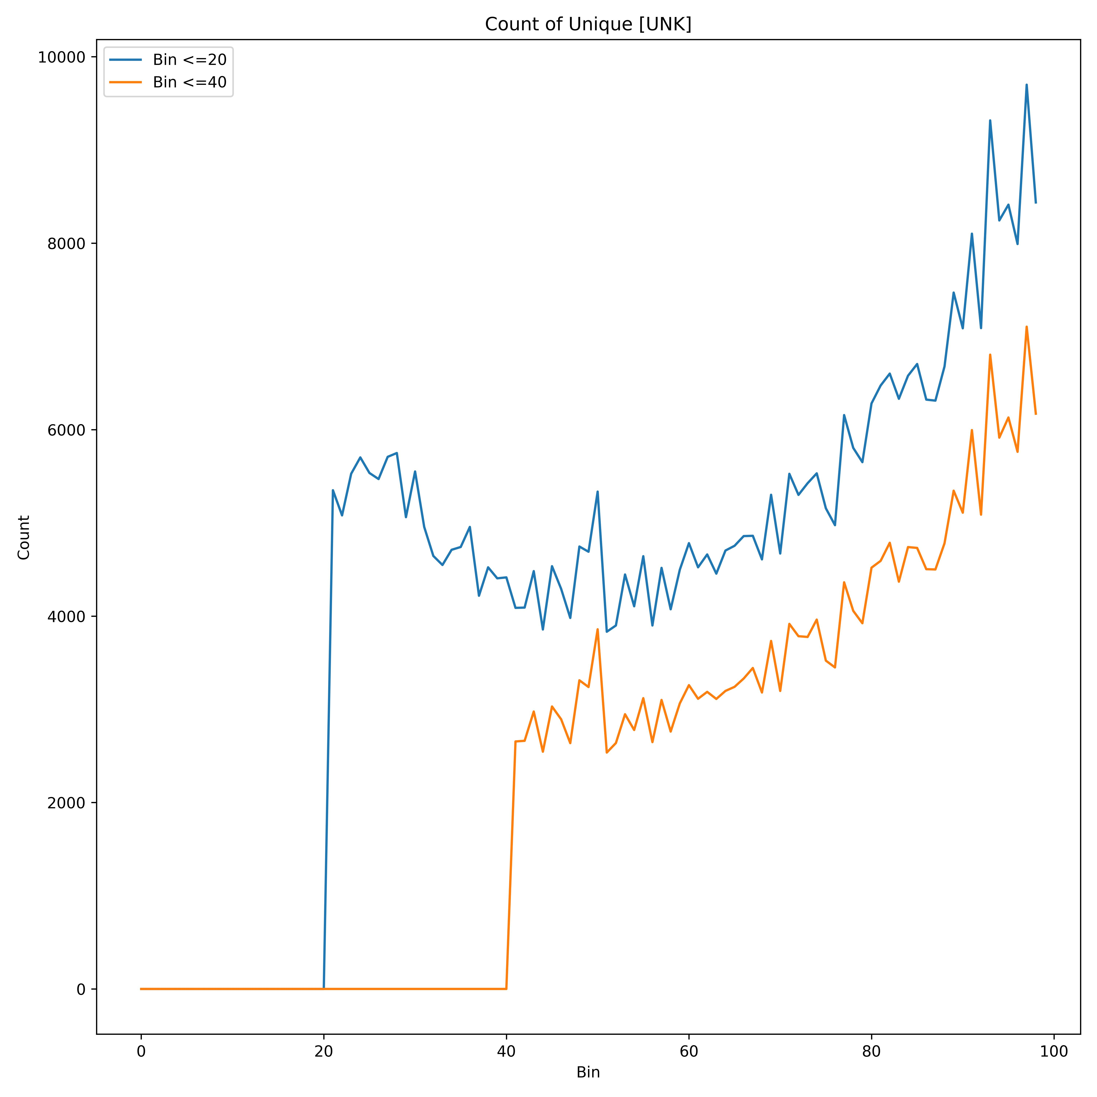
Emergence of New/UNK Tokens
Experiment: Consider all of the unique tokens found in all bins up to bin $k$ as our vocabulary
Count the number of unique unknown tokens which appear in future bins
The number of unknown words is consistently increasing.

Slide 37
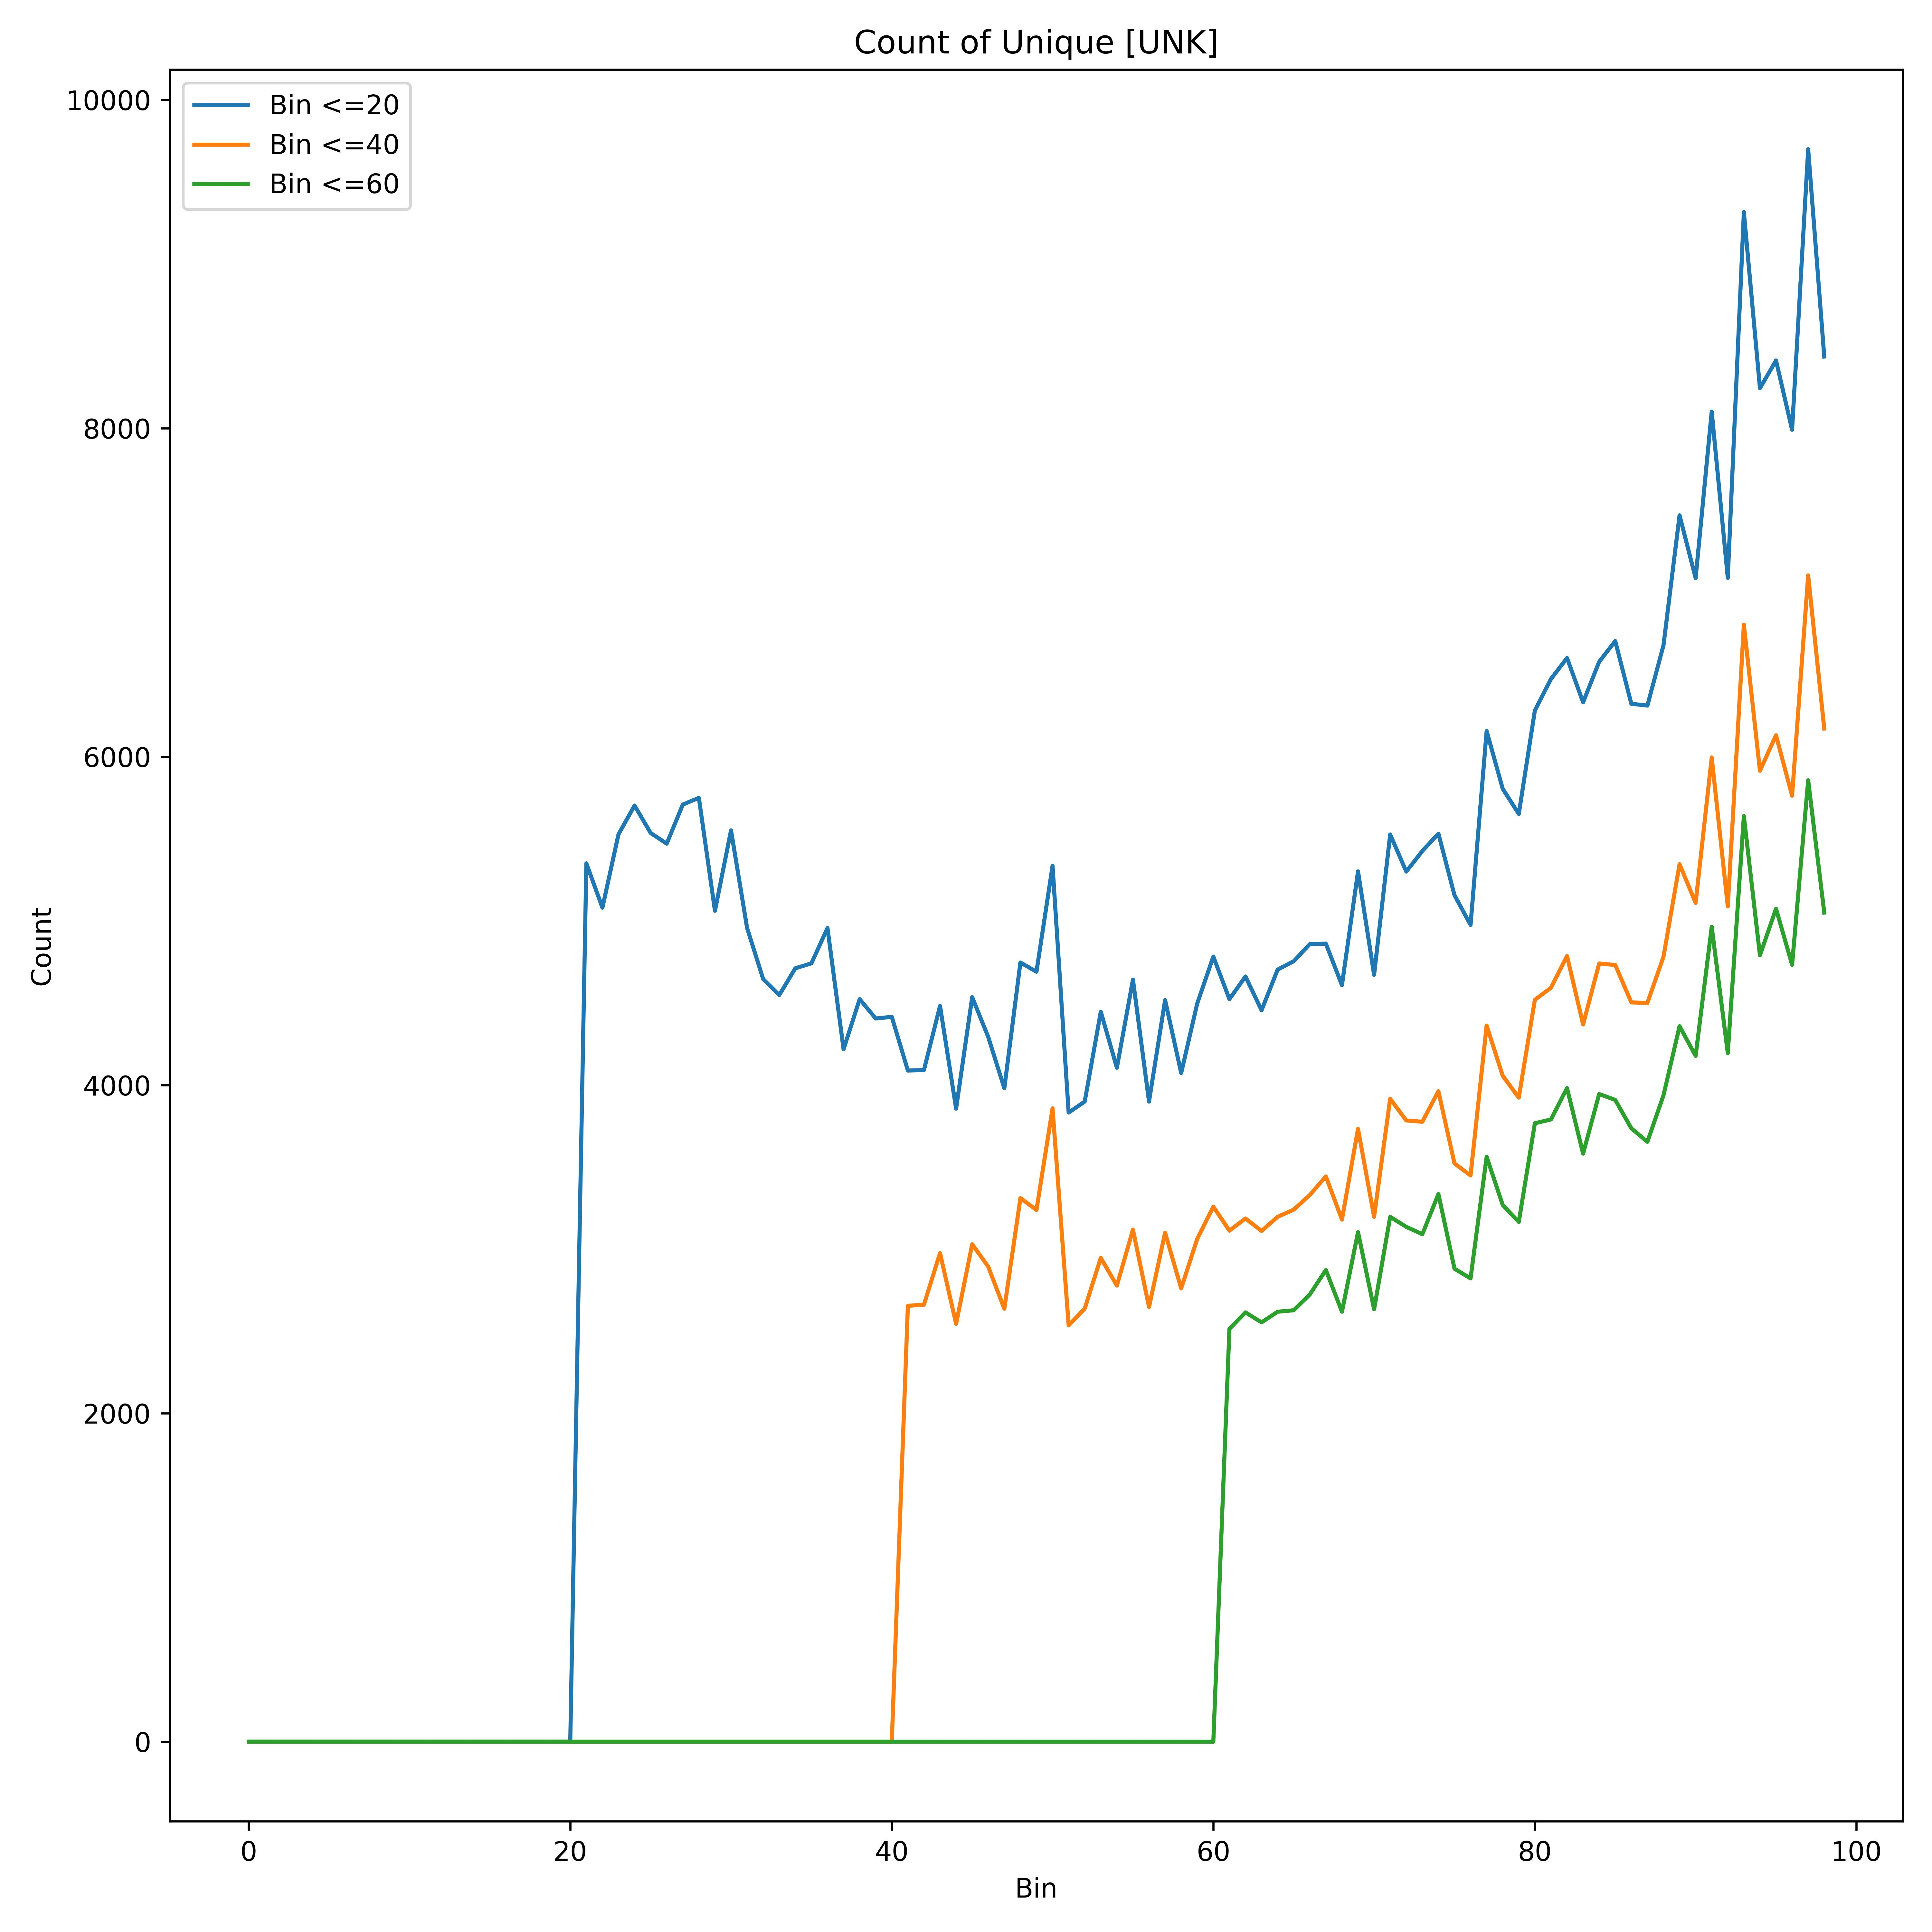
Emergence of New/UNK Tokens
Experiment: Consider all of the unique tokens found in all bins up to bin $k$ as our vocabulary
Count the number of unique unknown tokens which appear in future bins
The number of unknown words is consistently increasing.

Slide 38
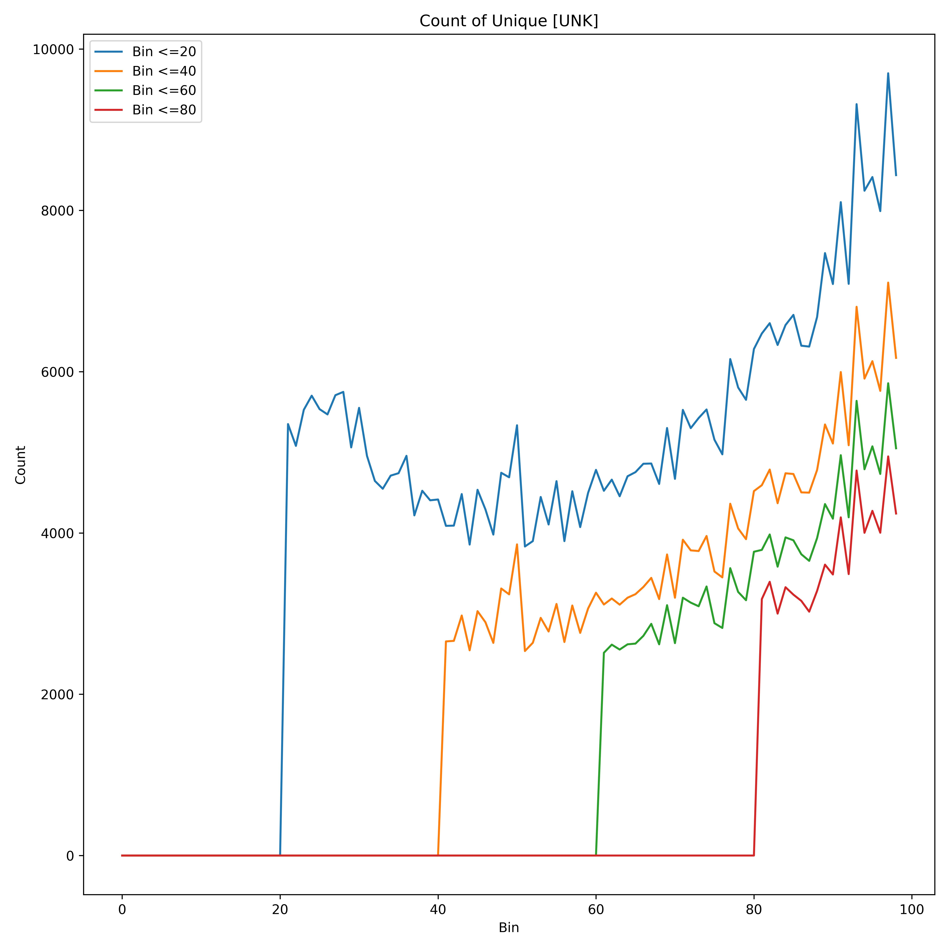
Emergence of New/UNK Tokens
Experiment: Consider all of the unique tokens found in all bins up to bin $k$ as our vocabulary
Count the number of unique unknown tokens which appear in future bins
Regardless of the vocabulary size, the number of unknown words is consistently increasing.
There are always words which did not appear in the previous years, and our models will have to handle this

Slide 39
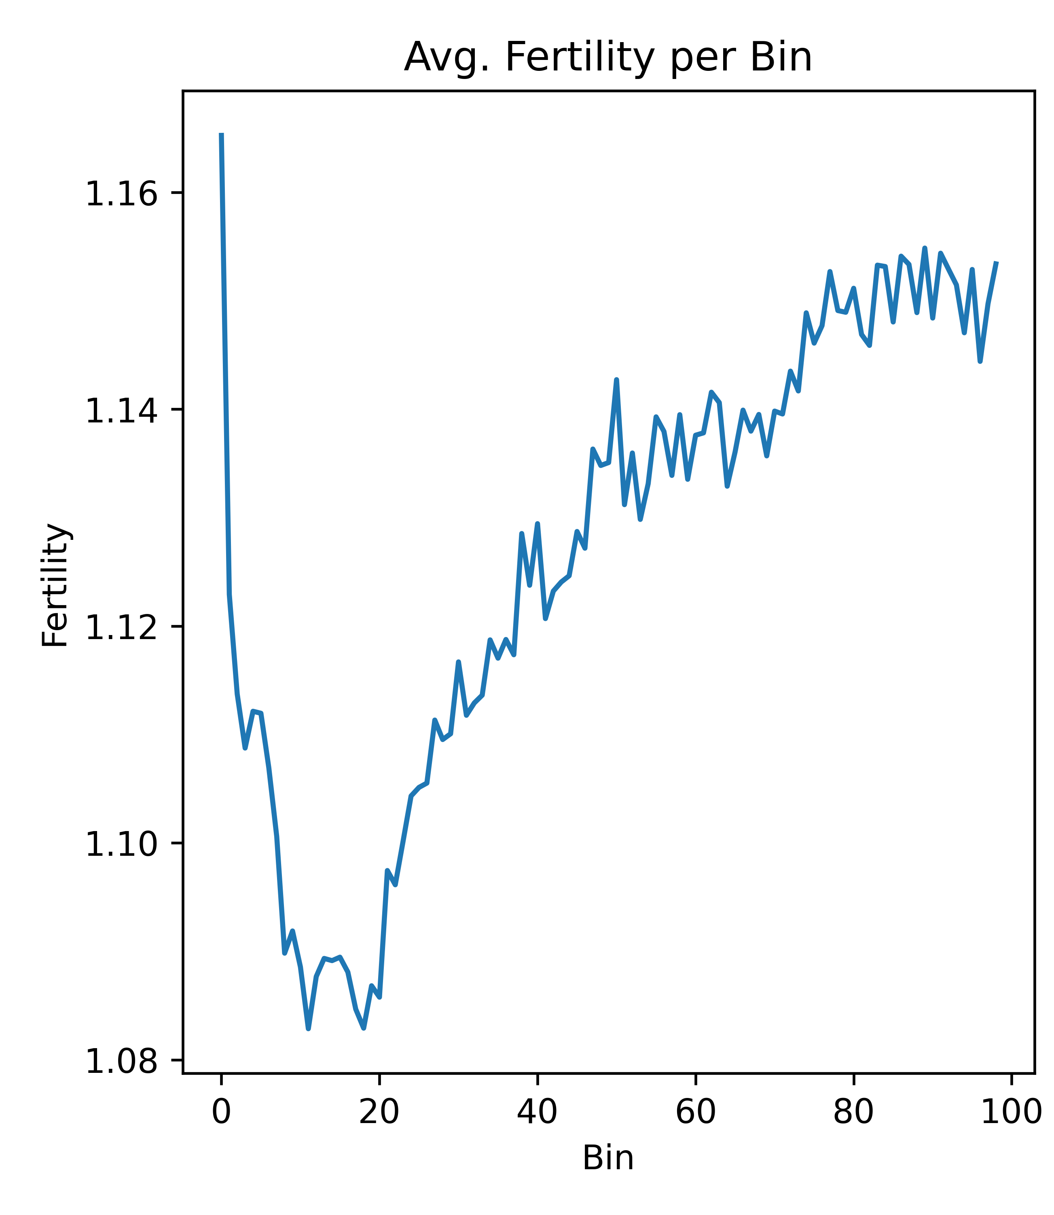
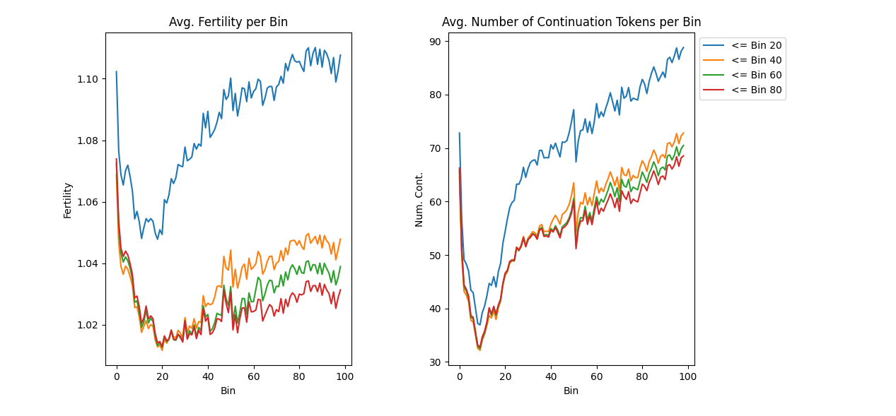
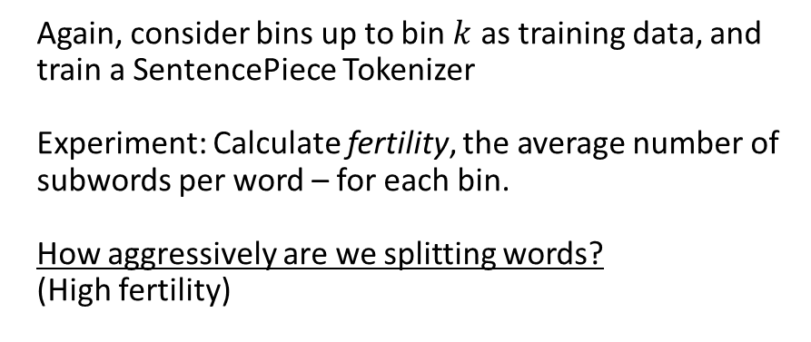
Subword Tokenizers over Time: Fertility
Again, consider bins up to bin $k$ as training data, and train a SentencePiece Tokenizer
Experiment: Calculate fertility, the average number of subwords per word – for each bin.
How aggressively are we splitting words?
(High fertility)
Fertility is increasing over time

Slide 40
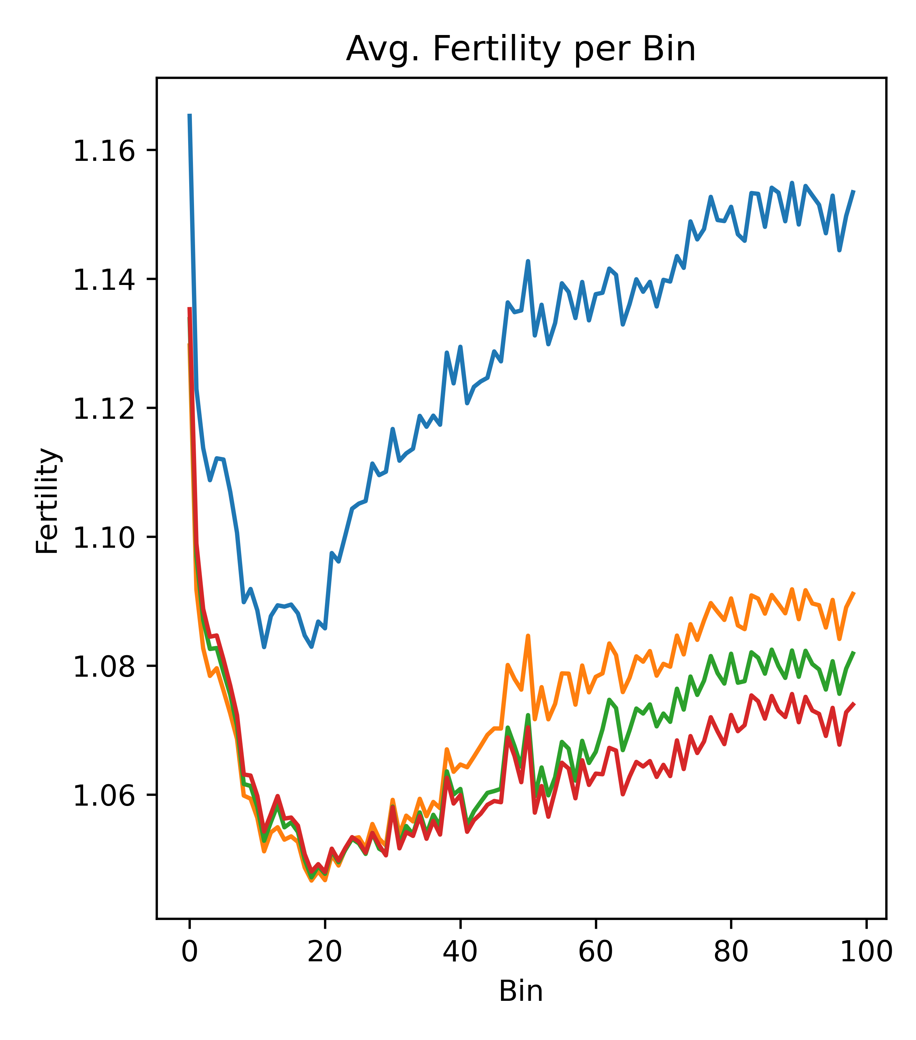
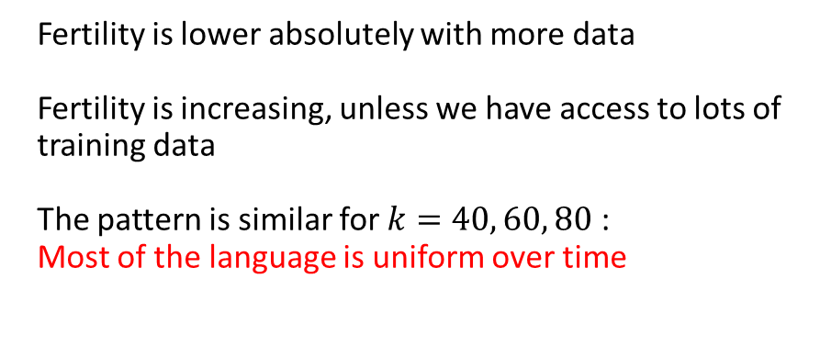
Subword Tokenizers over Time: Fertility
Again, consider bins up to bin $k$ as training data, and train a SentencePiece Tokenizer
Experiment: Calculate fertility, the average number of subwords per word – for each bin.
How aggressively are we splitting words?
(High fertility)
Fertility is lower absolutely with more data
Fertility is increasing, unless we have access to lots of training data
The pattern is similar for $k=40, 60, 80$ :
Most of the language is uniform over time

Slide 41

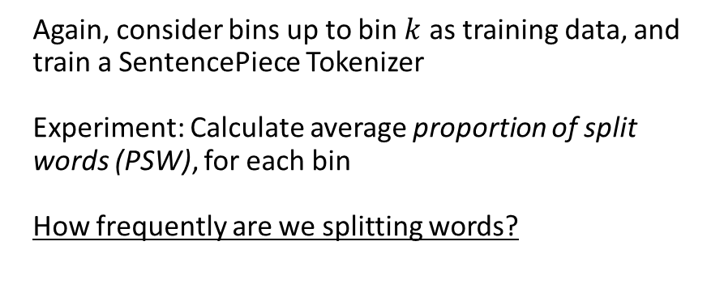
Subword Tokenizers over Time: PSW
Again, consider bins up to bin $k$ as training data, and train a SentencePiece Tokenizer
Experiment: Calculate average proportion of split words (PSW), for each bin
How frequently are we splitting words?
PSW is consistently increasing over time

Slide 42
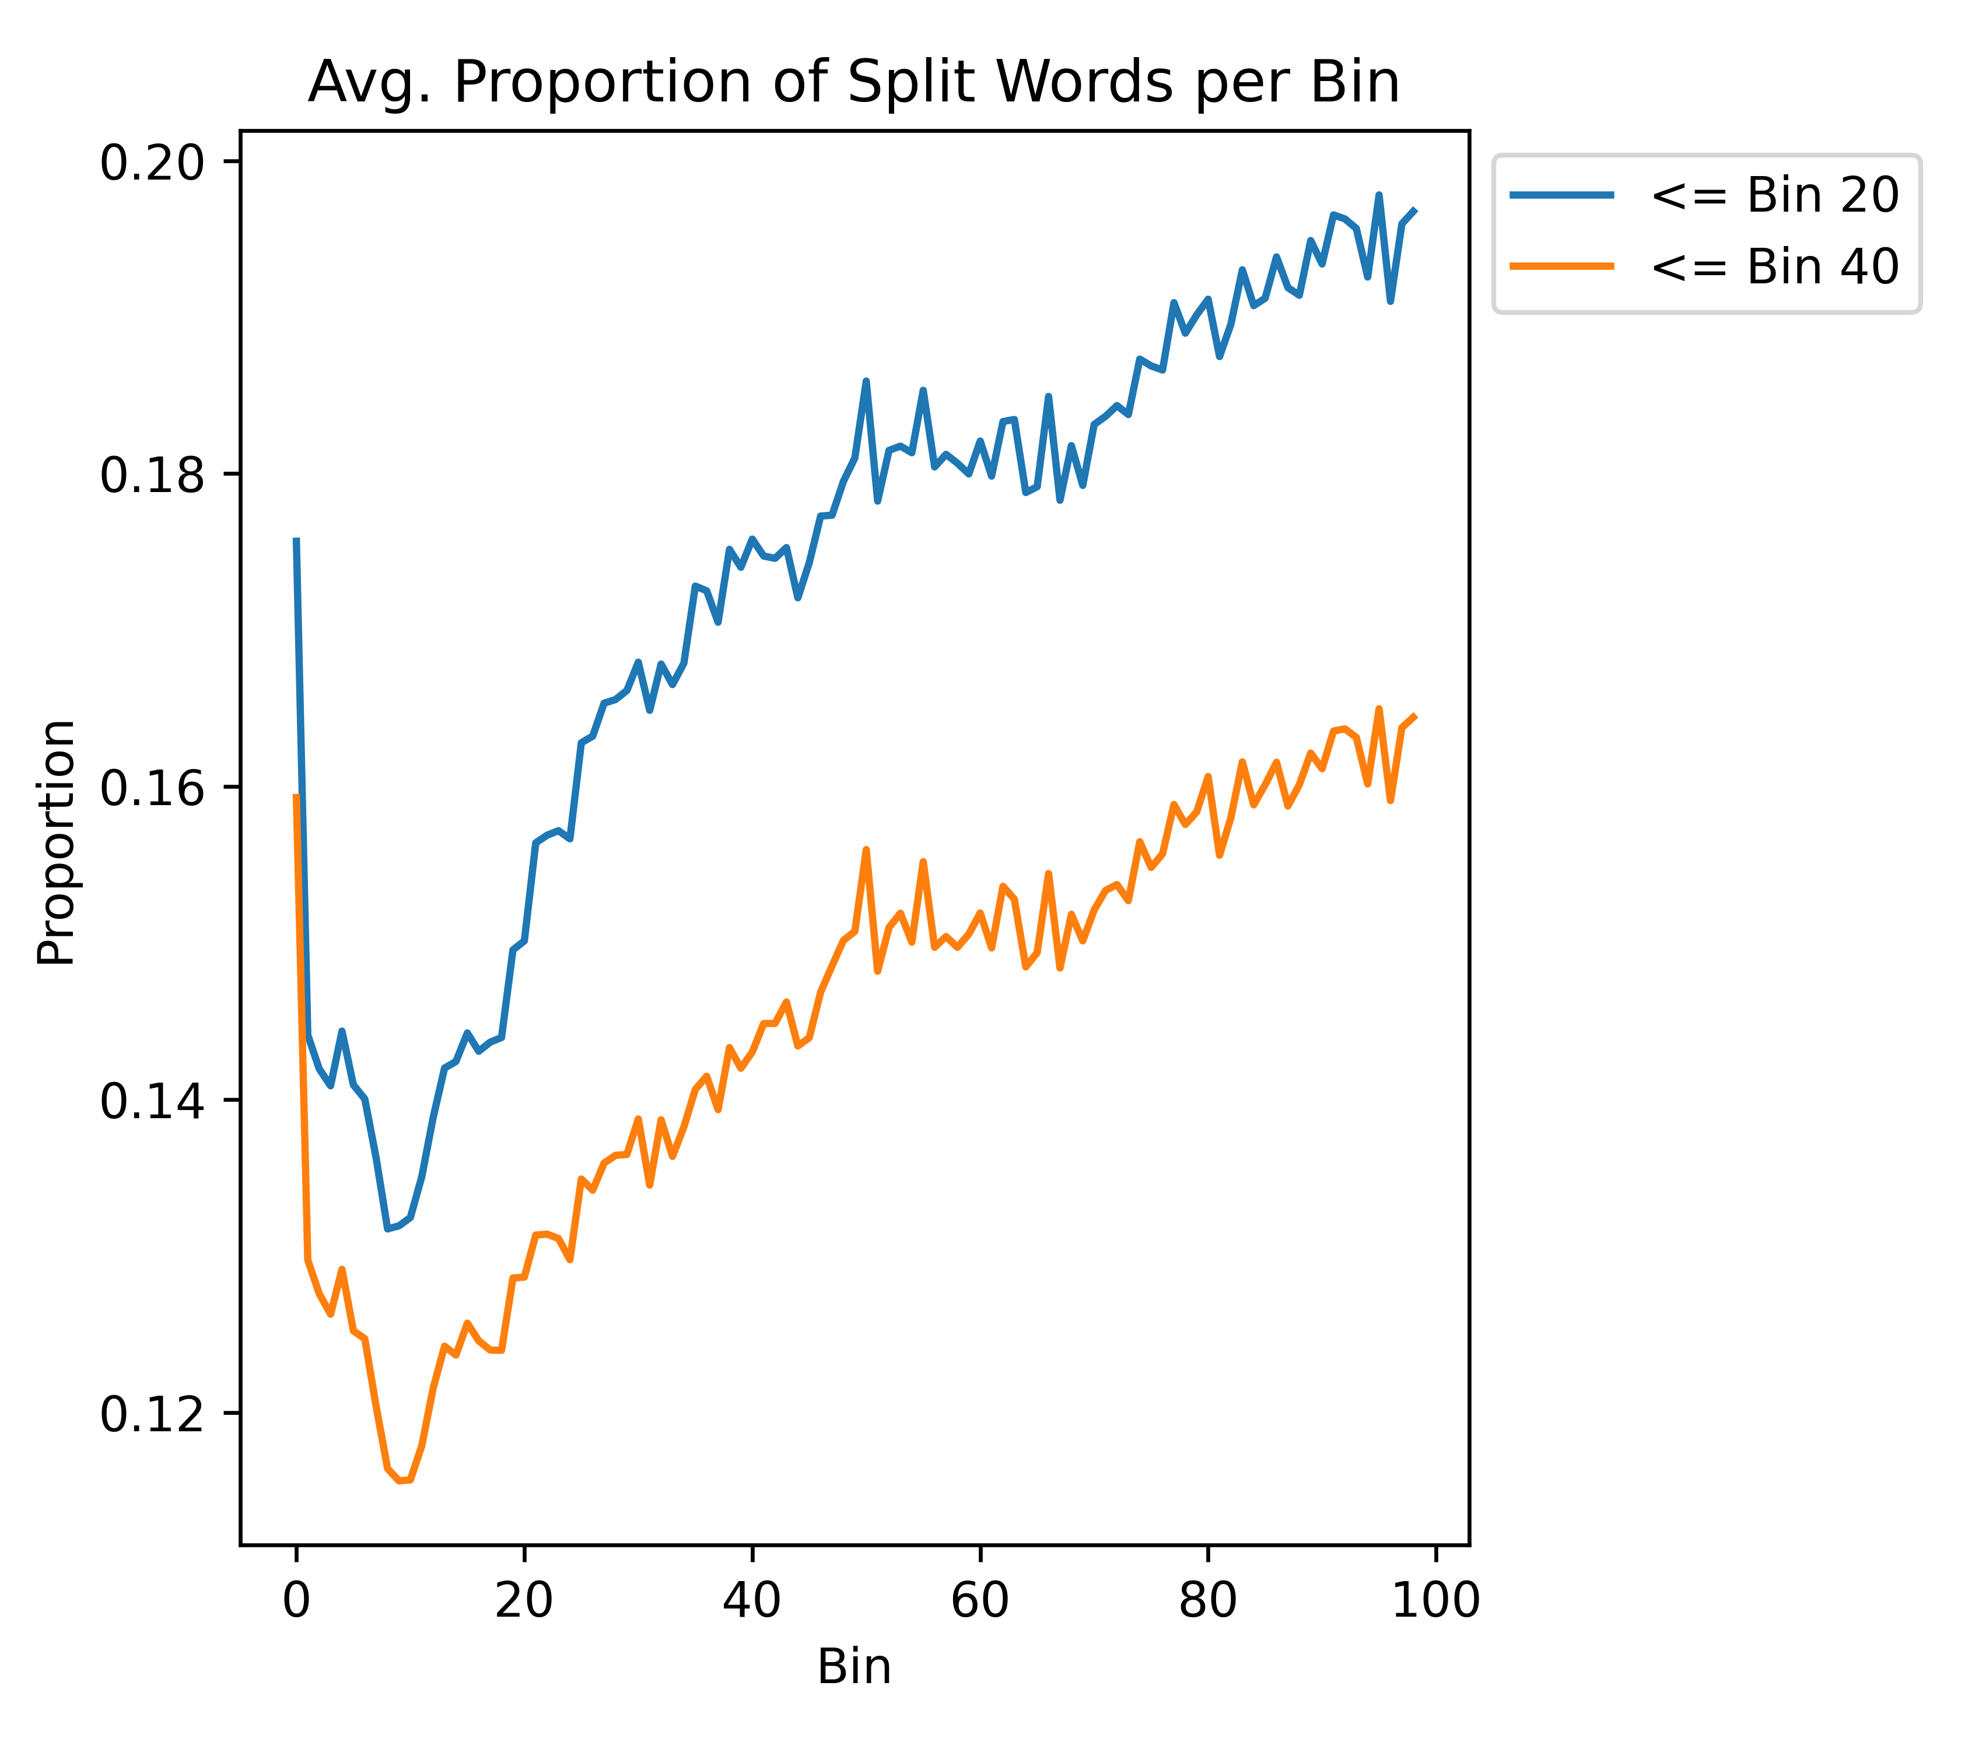
Subword Tokenizers over Time: PSW
Again, consider bins up to bin $k$ as training data, and train a SentencePiece Tokenizer
Experiment: Calculate average proportion of split words (PSW), for each bin
How frequently are we splitting words?
PSW is consistently increasing over time

Slide 43

Subword Tokenizers over Time: PSW
Again, consider bins up to bin $k$ as training data, and train a SentencePiece Tokenizer
Experiment: Calculate average proportion of split words (PSW), for each bin
How frequently are we splitting words?
PSW is consistently increasing over time
Training on more data doesn’t help
Models will have to handle new vocabulary words
Vocabulary size must increase to preserve good representations

Slide 44
Summary
Perplexity is predictable from bin to bin
Shown that the scientific literature is multilingual, while our models are not
Large effect on the perplexity, and representation for non-Latin script languages will be effectively random
RQ1: This effect varies across time
Shown that while the language of the text may be consistent, new terms are constantly appearing
RQ2: Language models will likely need to be updated to handle these new terms, both in terms of additional training as well vocabulary adaptation
Better Together: A scientific paper’s text can give important and fine-grained information on its content, but only if we can accurately encode it.
The majority of papers will present challenges towards this encoding. In most of these cases, the citation graph will be able to fill in the gaps.

